Slide 1

Motor Control
Chad Williams
University of Victoria

Slide 2
Lecture Outline
Motor Control
Hierarchical Motor Control
Skeletal & Muscle
Spinal Cord
Primary Motor Regions
Secondary Motor Regions

Slide 3
Lecture Outline
Motor Control
Hierarchical Motor Control
Skeletal & Muscle
Spinal Cord
Primary Motor Regions
Secondary Motor Regions

Slide 4

Motor Control
Motor Control
Reflexes: Simple, consistent responses to sensory stimuli
Involuntary
Motor Plan/ Program: Complex sets of commands to muscles established before behaviour
Voluntary

Slide 5

Motor Control
Speed-Accuracy Tradeoff: A negative relationship between speed and accuracy
Closed-Loop Control: Control achieved by adjusting motor commands to external feedback
Continuous process until desired movement is achieved
Maximizes accuracy
e.g., keeping stable on ice

Slide 6
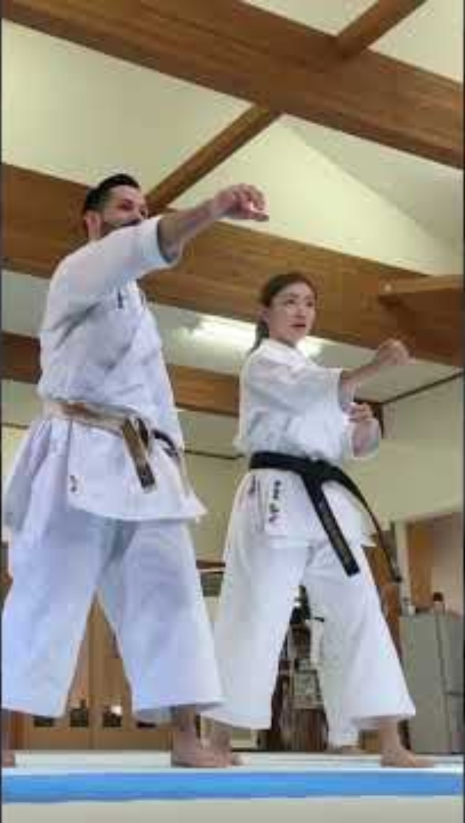
Motor Control
Speed-Accuracy Tradeoff
Open-Loop Control: Preprogrammed responses that do not integrate external feedback during movement
Rapid process that does not allow time for feedback integration
Maximizes speed
Correcting these responses require adapting the program across occurrences
E.g., speeded punch in martial arts

Slide 7
Lecture Outline
Motor Control
Hierarchical Motor Control
Skeletal & Muscle
Spinal Cord
Primary Motor Regions
Secondary Motor Regions

Slide 8
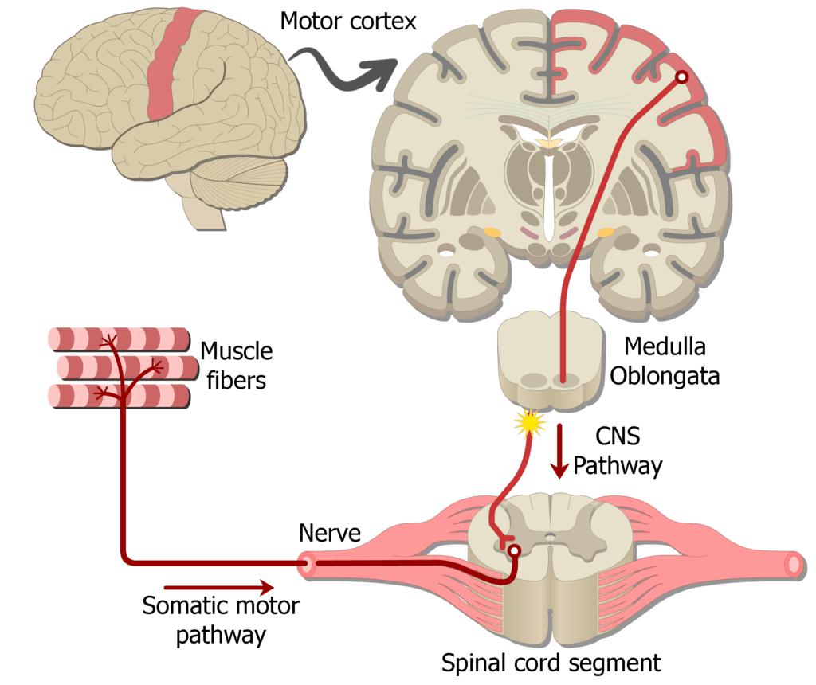
Hierarchical Motor Control
Levels of Hierarchy
Skeletal System: Bones and attached muscles determine possible movements
Spinal Cord: Controls muscles in response to sensory information
Brainstem: Integrates motor commands, transmits to spinal cord
Motor Cortices: Initiation of main motor commands
Brainstem

Slide 9
Lecture Outline
Motor Control
Hierarchical Motor Control
Skeletal & Muscle
Spinal Cord
Primary Motor Regions
Secondary Motor Regions

Slide 10
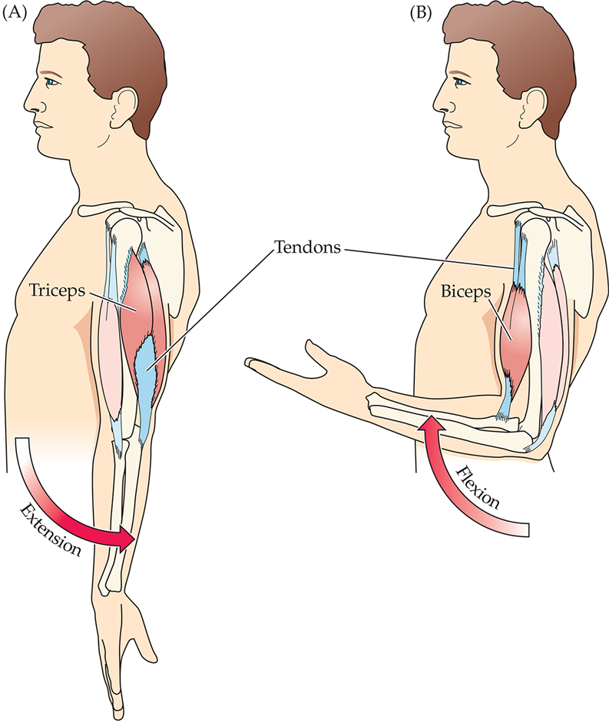
Skeletal & Muscle System
Skeletal & Muscle System
Skeleton mechanically determines possible movements
Move through the contraction (shortening) of muscles
Motor neurons: Contraction is driven by excitation
Synergists: Muscles that work together as a group
E.g., the three heads of the tricep
Antagonists: Muscles groups are paired in that the contraction of one will stretch the other
E.g., bicep vs tricep

Slide 11
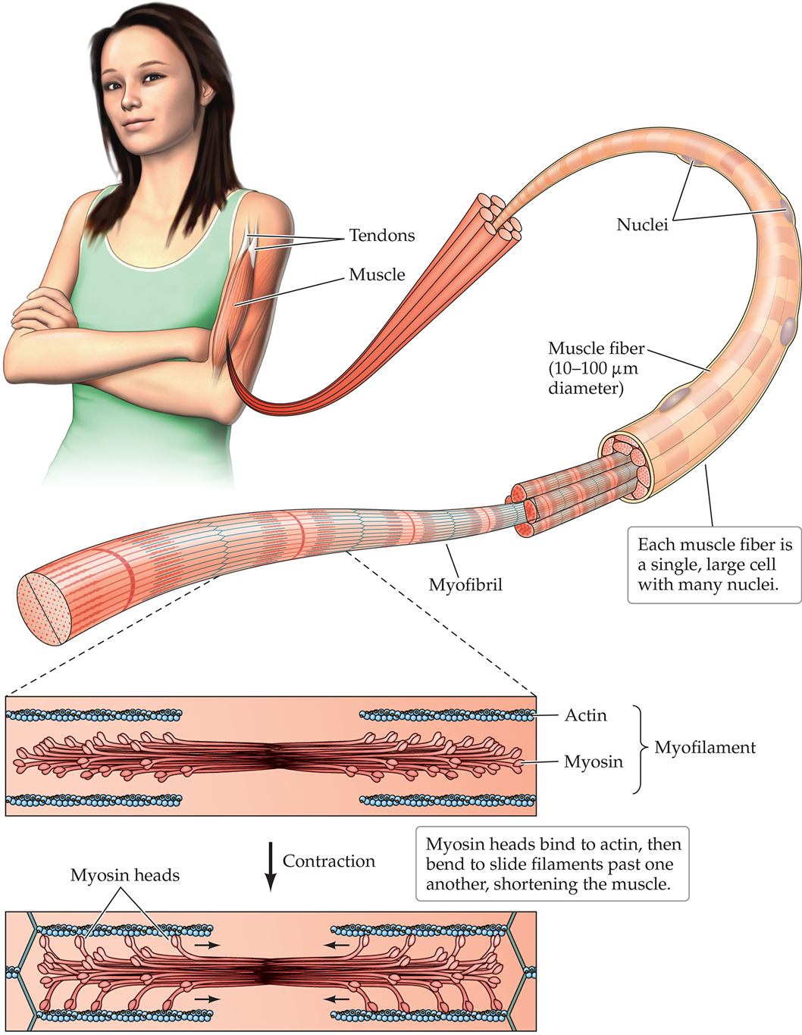
Skeletal & Muscle System
Anatomy of a Striated Muscle
Tendon: Connects muscle to skeleton
Muscle Fibers: Single large cell with many nuclei
Thousands work together to compose a muscle
Myofilaments: Protein filaments within muscle fibers that produce contraction
Actin and myosin
Organized into repeated sections called sarcomeres
The interaction between actin and myosin cause contraction

Slide 12
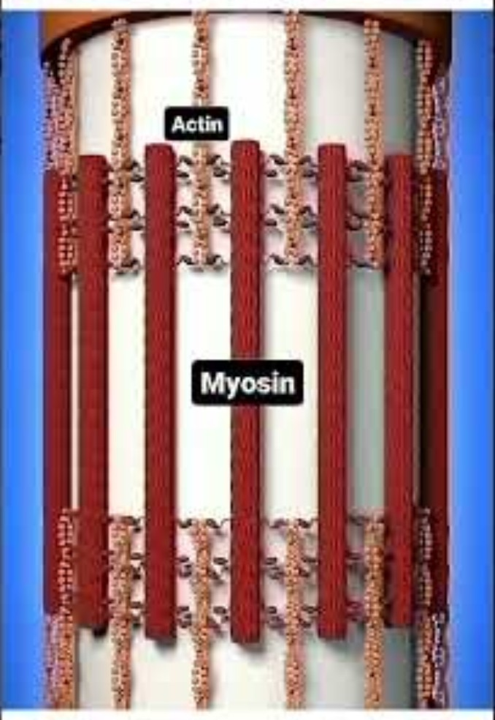
Skeletal & Muscle System
Anatomy of a Striated Muscle
Tendon: Connects muscle to skeleton
Muscle Fibers: Single large cell with many nuclei
Thousands work together to compose a muscle
Myofilaments: Protein filaments within muscle fibers that produce contraction
Actin and myosin
Organized into repeated sections called sarcomeres
The interaction between actin and myosin cause contraction

Slide 13
Skeletal & Muscle System
Anatomy of a Striated Muscle
Slow-Twitch (Type I): Produces slower, sustained contractions
Low force
High resistance to fatigue
Used in endurance activities
Postural maintenance, long-distance running

Slide 14
Skeletal & Muscle System
Anatomy of a Striated Muscle
Fast-Twitch (Type IIa): Produces rapid contractions
Medium force
Moderate resistance to fatigue
Used in repeated rapid movements
Middle-distance running, repeated sprinting
Fast-Twitch (Type IIx): Produces very rapid, powerful contractions
High force
Low resistance to fatigue
Used in maximal explosive movements
Sprinting, jumping, Olympic lifting

Slide 15
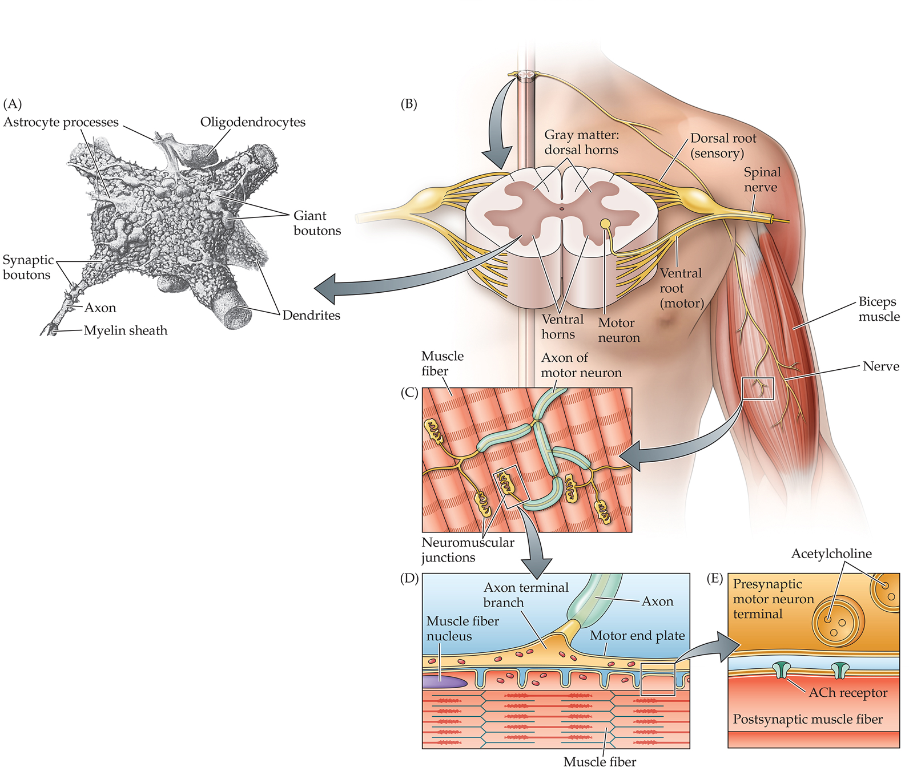
Skeletal & Muscle System
Motor Neurons
Largest neuron in the spinal cord
Up to a meter long in humans

Slide 16
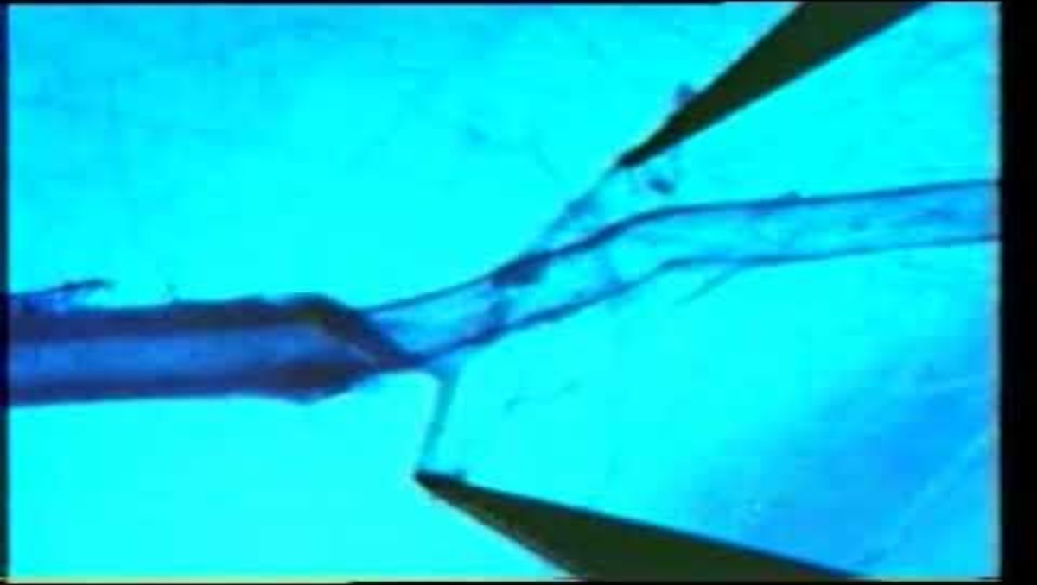

Slide 17
Skeletal & Muscle System
Motor Neurons
Largest neuron in the spinal cord
Up to a meter long in humans
Only releases acetylcholine (ACh)
Excites muscle fibers that have their own action potential
Entering Na⁺ and Ca²⁺ causes changes in myosin and actin, producing contraction
Neuromuscular Junction (NMJ)
The synaptic cleft between neuron and muscle
Many of these exists per motor neuron
Larger site than neuron-neuron synapses

Slide 18
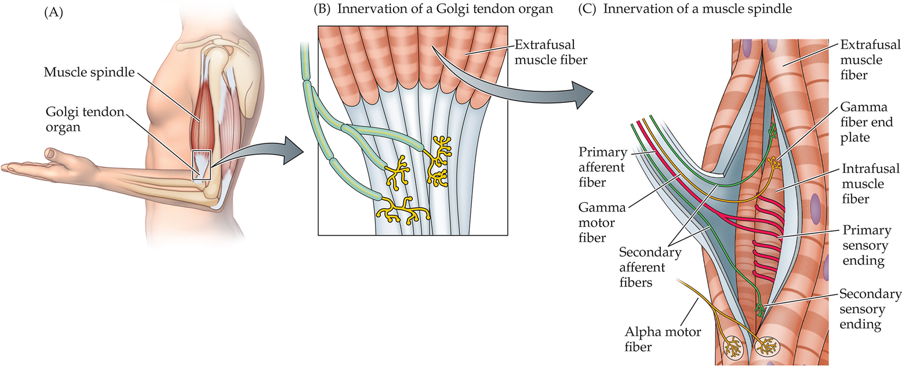
Skeletal & Muscle System
Proprioception: Perception of body movements and position
Includes two proprioceptive receptor cells, muscle spindles and Golgi tendon organs
Perceives length and tension of muscle
Driven by stretch-sensitive ion channels
Similar to touch

Slide 19
Skeletal & Muscle System
Proprioception
Muscle Spindles
Monitor muscle length
Primary Sensory Endings: Respond quickly and to early changes in stretch
Velocity of muscle stretch
Secondary Sensory Endings: Respond slowly and to maintained muscle length
Static stretch

Slide 20
Skeletal & Muscle System
Proprioception
Golgi Tendon
Monitor muscle tension
Monitors the force of muscle contraction
Protective: Monitor overloads that threaten to tear muscles and tendons
Strong stimulation inhibits motor neurons, relaxing the contraction and tension

Slide 21
Lecture Outline
Motor Control
Hierarchical Motor Control
Skeletal & Muscle
Spinal Cord
Primary Motor Regions
Secondary Motor Regions

Slide 22
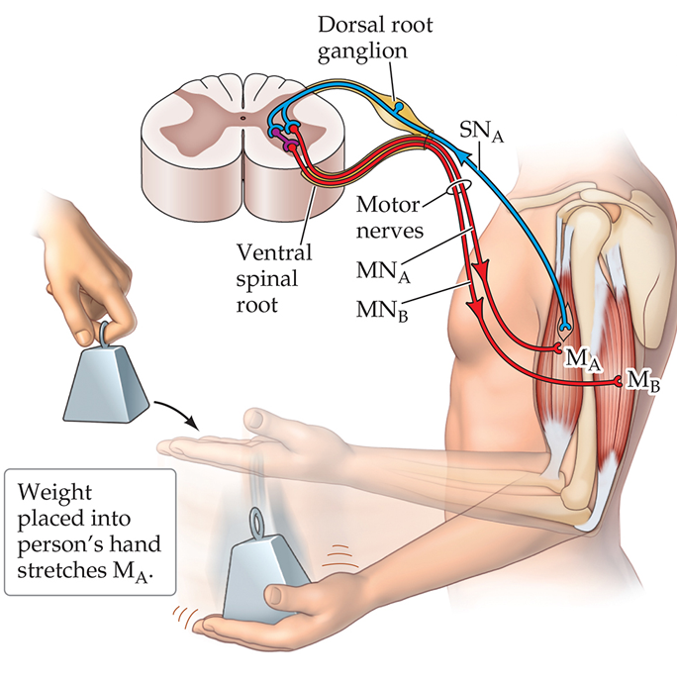
Spinal Cord System
Automatic Responses in Spinal Cord: Motor commands that do not require cognition (brain)
Stretch Reflex: A sensory neuron activates motor neurons in the spinal cord
Sensory neurons enter spinal cord
They synapse directly with motor neurons to contract the target muscle
They also synapse with interneurons, which inhibit motor neurons to relax the antagonist muscle
E.g., placing a weight on hand requires more contraction of bicep, and more stretching of tricep, to keep hand stable

Slide 23
Spinal Cord System
Automatic Responses in Spinal Cord
Central Pattern Generators
Neurons in spinal cord produce autonomous, rhythmic control of movement
Does not need brain signals or external feedback
Rhythmic, repetitive cycles of the same movement (e.g., walking)

Slide 24
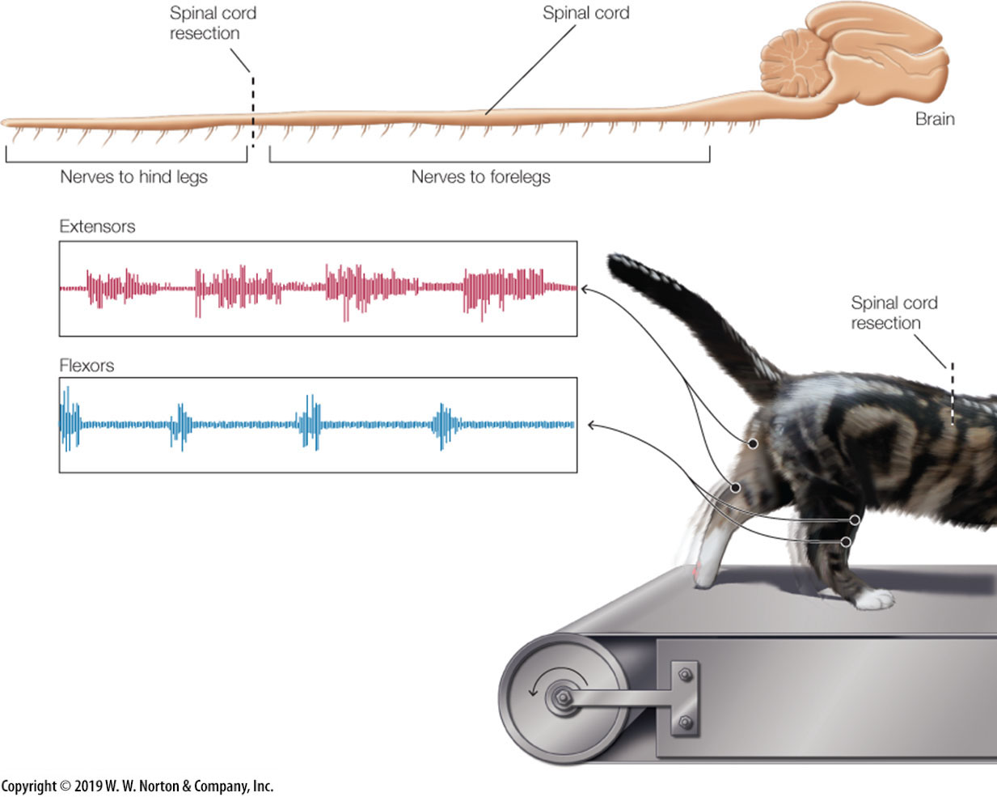
Spinal Cord System
Central Pattern Generators
Brown, 1911
Research Question: Can the spinal cord generate rhythmic movements without inputs from the brain or senses?
Task: Severed control (brain) and feedback (senses) information from the CPG network and observed whether the cat could walk normally on a treadmill
Independent Variable: Surgically cut nerves in the spinal cord
Severed brain and sensory nerves

Slide 25
Spinal Cord System
Central Pattern Generators
Brown, 1911
Dependent Variable: Extracellular recording of motor neuron activity specific to extensors and flexors
Extensors: Contraction straightens a joint
Flexors: Contraction bends a joint
Results: Normal, rhythmic flexor and extensor contractions
Conclusion: Spinal cord contains intrinsic neural circuits (CPGs) that produce rhythmic movements without the brain or senses

Slide 26
Lecture Outline
Motor Control
Hierarchical Motor Control
Skeletal & Muscle
Spinal Cord
Primary Motor Regions
Secondary Motor Regions

Slide 27
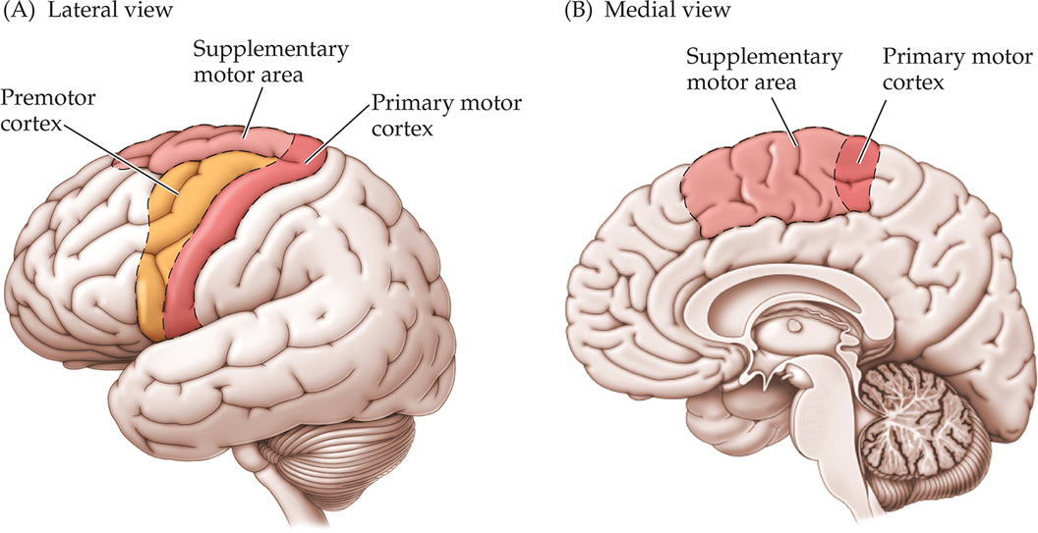
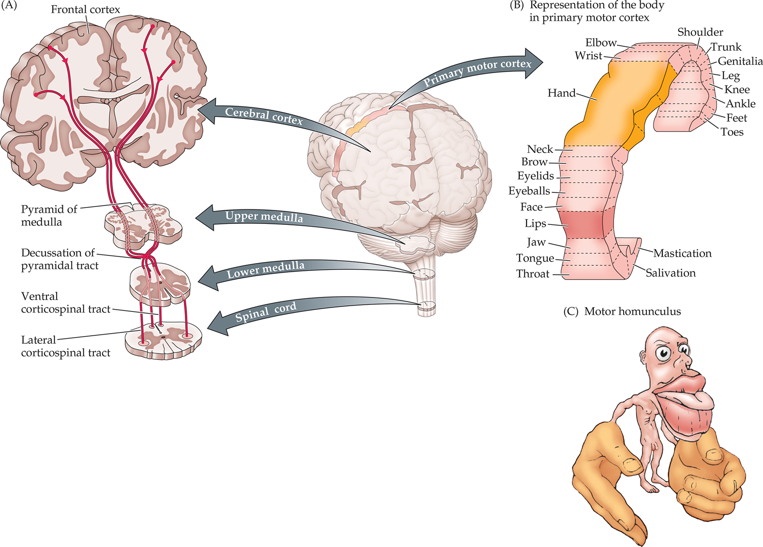
Primary Motor Regions
Primary Motor Cortex (M1)
Motor homunculus: Cortical territory proportional to the precision and fine motor control required by a body part
Body parts requiring less precise control are represented by fewer neurons
E.g., trunk, back
Body parts requiring greater dexterity are represented by more neurons
E.g., fingers, tongue
Individual neurons in M1 are directionally tuned
Each neuron fires most strongly when movement occurs in a specific preferred direction

Slide 28
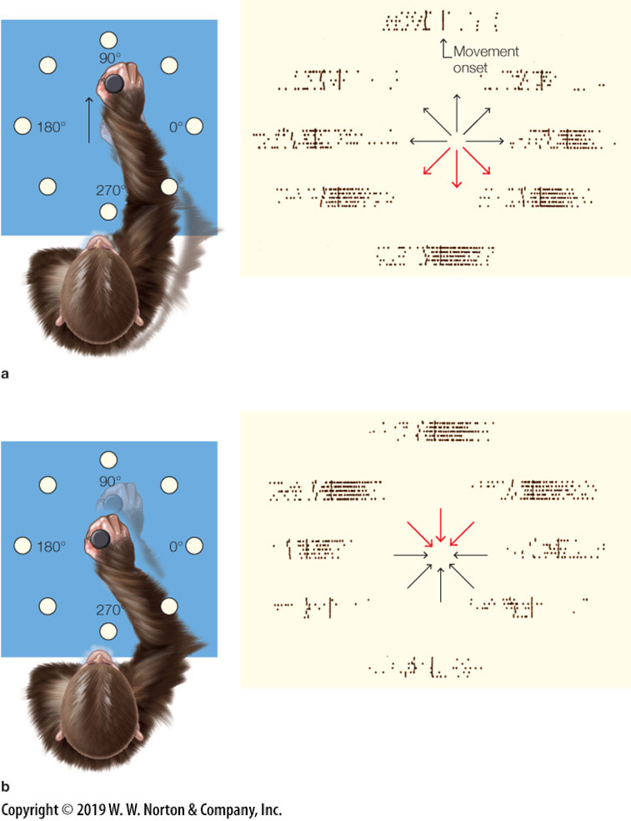
Primary Motor Regions
Georgopoulos et al. (1982)
Research Question: How do M1 neurons code movement?
Task: Monkeys move a lever towards light arranged in a circle
Then move the lever back to center
IV: Direction of movement

Slide 29
Primary Motor Regions
Georgopoulos et al. (1982)
DV: Single-cell recording of individual neurons
Results: Each neuron showed a tuning curve
Highest firing rate at a preferred direction
Conclusion: M1 neurons are directionally tuned
Similar directional coding has since been found in other motor areas, including the premotor cortex

Slide 30
Primary Motor Regions
Primary Motor Cortex (M1)
Neuroplasticity
Neural structure increases with learning of a skill
Represents increased complexity to represent the skill
Neural activity may increase or decrease with learning, depending on the type of skill
Decreases with simple repetitive tasks, representing more efficient neural coding
Increases with complex, highly refined skills, reflecting expanding structural representation

Slide 31
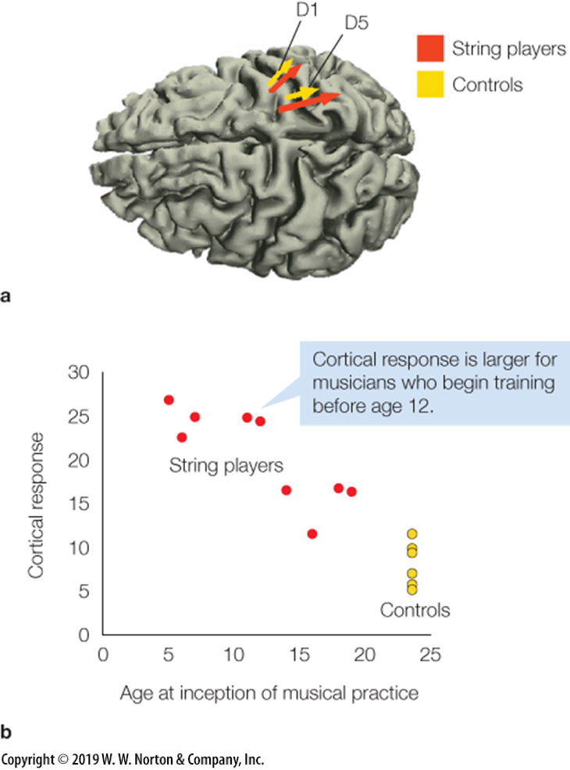
Primary Motor Regions
Elbert et al., 1995
Research Question: Is the organization of the primary motor cortex malleable?
Task: Stimulation of thumb and finger of the hand of musicians and non-musicians
IV: Violin players versus non-musicians
Also, years playing violin
DV: Neural activity of the motor cortex using MEG

Slide 32
Primary Motor Regions
Elbert et al., 1995
Results:
Increased activity in primary motor cortex for violin players
The neural response positively correlated with years as a musician
Conclusion: There exists plasticity within the motor cortex
Experience reshapes cortical organisation

Slide 33
Lecture Outline
Motor Control
Hierarchical Motor Control
Skeletal & Muscle
Spinal Cord
Primary Motor Regions
Secondary Motor Regions

Slide 34
Secondary Motor Regions
Premotor: Planning of movement respective of external stimuli
Strong connection with parietal lobe (senses)
Contains mirror neurons – neurons that fire both when performing and observing an action
E.g., defensive movements in response to threat, reaching for food

Slide 35
Secondary Motor Regions
Supplementary Motor Area: Planning of movement respective of internal stimuli
Strong connection with medial frontal cortex (goals)
Active during mental rehearsal of a movement, even without executing the movement
E.g., deciding to get out of bed to start the day, playing a memorized piano sequence

Slide 36
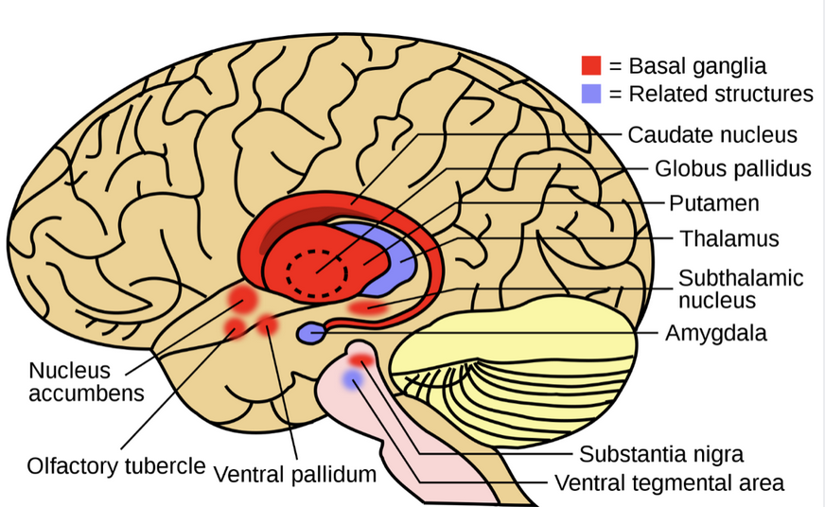
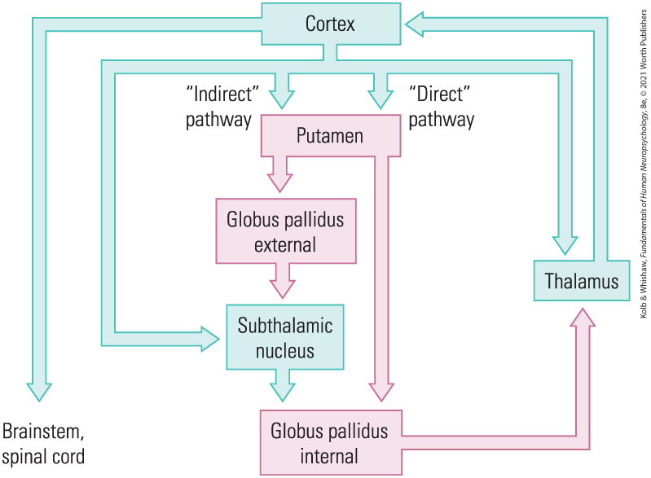
Secondary Motor Regions
Basal Ganglia: A collection of subcortical nuclei involved in movement initiation, force generation, and action selection
Generate the force required for each movement
Dorsal Striatum
Caudate nucleus and Putamen
Motor Control: Regulates movement initiation and force
Action Selection: Selects intended motor program while suppressing competing actions
Ventral Striatum: Reward and motivation
Nucleus accumbens and olfactory tubercle
Reward-based learning and assignment of value to actions
Force Excitatory
Force Inhibitory

Slide 37
Secondary Motor Regions
Basal Ganglia
Subthalamic Nucleus: Suppressing unwanted movements
Acts as a motor brake
Globus Pallidus Internal (GPi): Acts as the output regulator of the basal ganglia
Inversely related to force
Excitation inhibits the thalamus and M1, reducing force
Inhibition excites the thalamus and M1, increasing force
Force Excitatory
Force Inhibitory

Slide 38
Secondary Motor Regions
Basal Ganglia
Globus Pallidus Internal (GPi)
Direct pathway (go pathway)
Cortex → Putamen → GPi
Inhibits GPi
Increases movement
Indirect pathway (stop pathway)
Cortex → Putamen → GPe → Subthalamic Nucleus → GPi
Excites GPi
Suppresses movement
Force Excitatory
Force Inhibitory

Slide 39
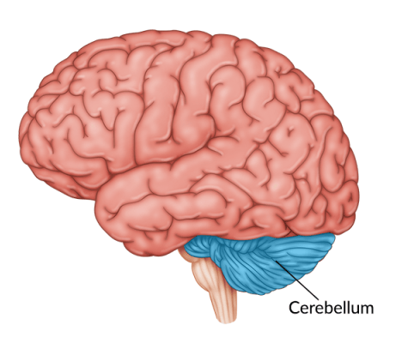
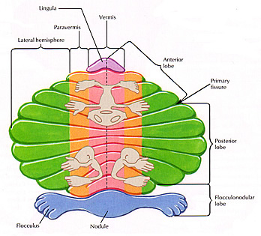
Secondary Motor Regions
Cerebellum
Coordinates and fine-tunes voluntary movement
Coordinates muscles to work together
Ensures smooth movement
Corrects errors during movement
Ensures precise movements
Maintains posture and balance
Has somatotopic organization
Body regions are mapped onto the surface

Slide 40
Secondary Motor Regions
Cerebellum
Flocculus: Controls balance and eye movements
Integrates vestibular system for balance
Stabilizes gaze
Vermis: Posture and movement of midline muscles
Trunk and face
Maintains upright posture during standing and walking
Controls saccadic eye movements

Slide 41
Secondary Motor Regions
Cerebellum
Paravermis: Coordinates movement of distal limbs
Arms, legs, hands, feet, and digits
Ensures smooth movements
Corrects errors during actions
Lateral Hemisphere: Coordination and timing of complex voluntary movements
Contributes to cognitive planning and motor preparation
Connected to premotor and prefrontal cortex
Help refine and organize motor plans
Times and sequences complex actions

Slide 42
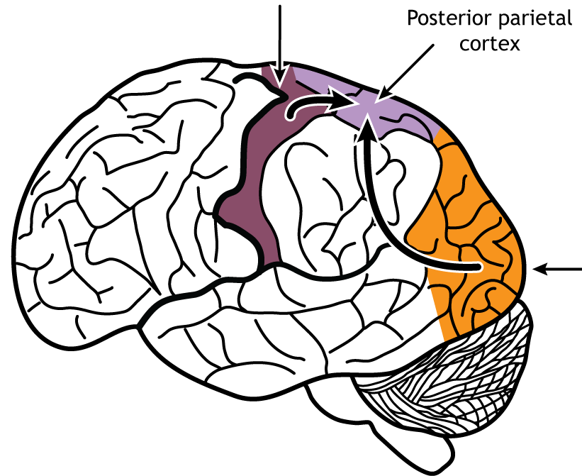
Secondary Motor Regions
Posterior Parietal Cortex (PPC)
Integrates visual, somatosensory, and proprioceptive input for spatial navigation
Translates sensory information into motor plans
Perceives the world and determines how to act
Encodes motor intentions, linking actions to goals

Slide 43

Testable Figures
Slide 34
Slide 36 (top figure)
All figures corresponding to the results of a study are testable material.

